Slide 1
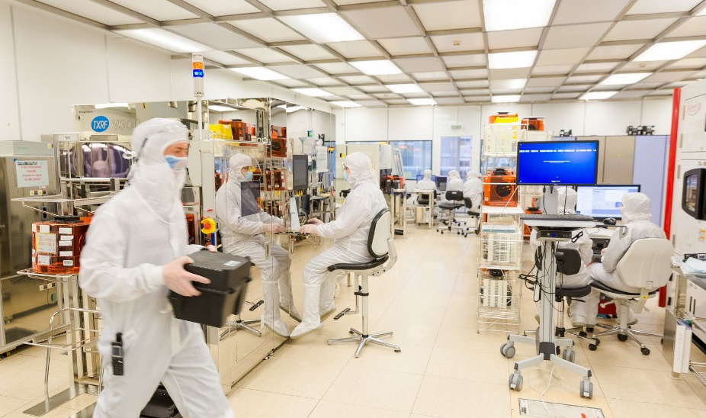
Workshop introduction

Slide 2
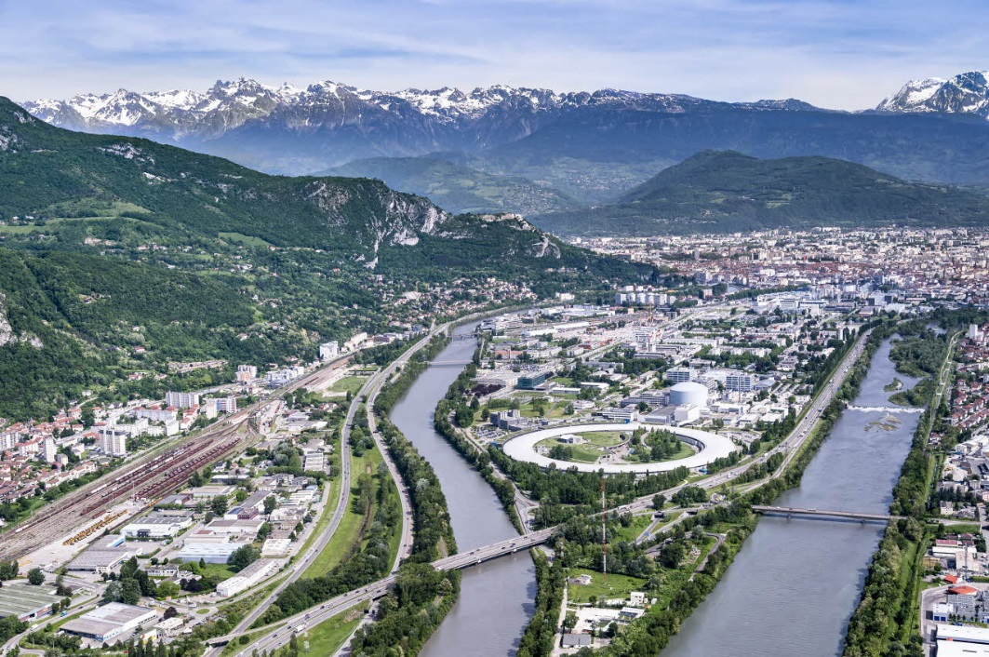
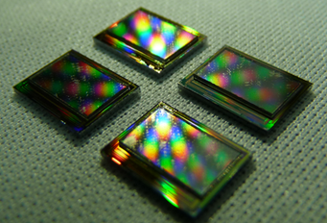
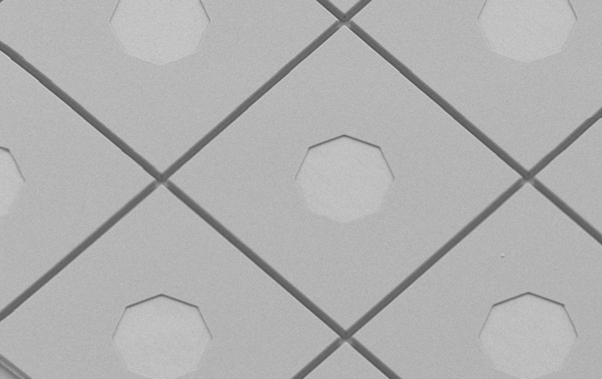
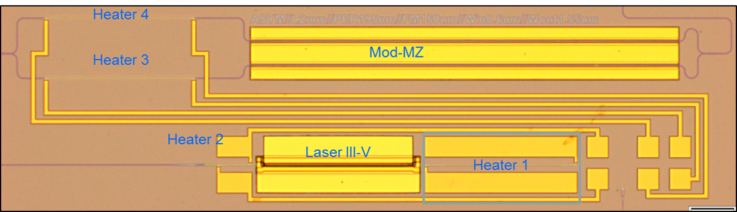



Leti, technology research institute
Optics and Photonics Division
Founded in 1967, based in France (Grenoble) / offices in USA and Japan
Created in 1978
300 researchers, engineers and PhD students
1900
People
2670
Patents in portfolio
60
Startups created
€315
Million budget
500 patents in portfolio
91 new patents in 2017
~55 M€ budget
90% from external revenue

Slide 3
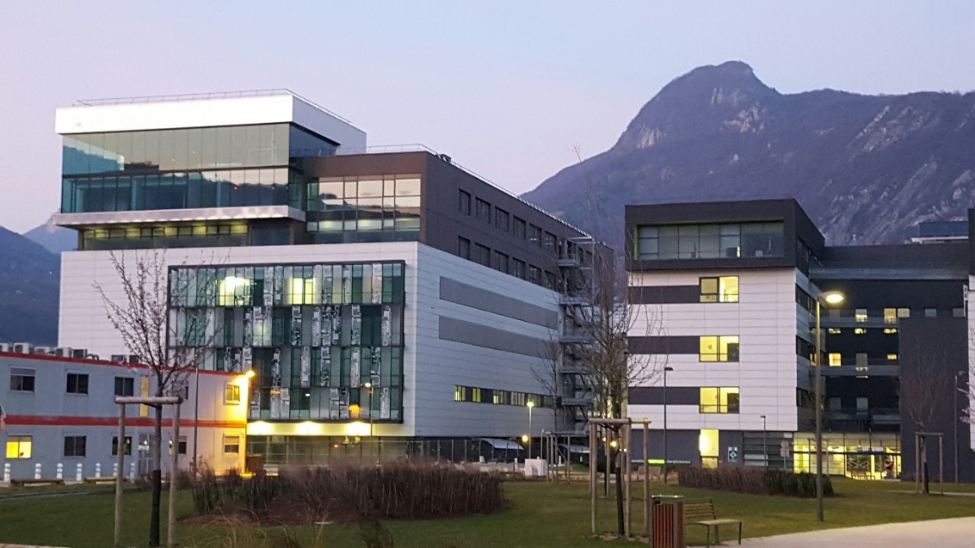
OUR RESEARCH FACILITIES
NEW in 2017 : PHOTONICS BUILDING
Other facilities and research activities in Leti
CMOS, 3D
MEMS
IC DESIGN
CHARACTERIZATION
COMPLEX SYSTEMS
HEALTHCARE
Dedicated clean rooms for III-V and II-VI materials (growth, epitaxy, process and packaging) on versatile substrate geometries up to 150 mm
Electro-optical test and characterization facilities
Design and simulation capabilities (process, growth, optics …)

Slide 4

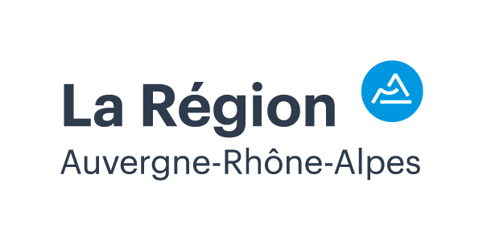

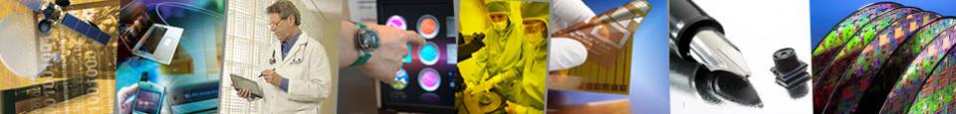
MINALOGIC : A first class ecosystem of Digital Technologies
Powerful local ecosystem of labs and industries
The Global innovation cluster, focused on Digital Technologies:
  +400 members in Photonics, Micro/nanoelectronics and Software
  Areas of Excellence: imaging & photonic sensors, surface engineering, Integrated optics, smart lighting & photonic energies, display…
A leading region in photonics
  25% of the French R&D activities
  25 certified subsidized projects in 2017
  an average of 7 startups created per year
  A cutting edge research in line with industrial needs
A complete and unified ecosystem

Slide 5



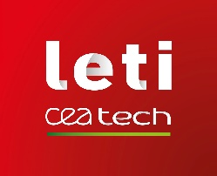




Together on PHOTONICS WEST,
Potential partners for your needs!
1746
5442
431
Advanced Infrared detectors
Deformable mirrors
adaptive optics
Technology research institute
miniaturization technologies
437
431
4329
High performance lasers
Waveguide devices
Industrial QCL solutions
Actuator solutions
1836
5436
CMOS, CCD and EM
image sensors and cameras
Laser spectrum analyzers
wavelength meters
David VITALE, Director, Photonics Department
david.vitale@minalogic.com, +33 (0)6 35 03 98 52
www.minalogic.com/en/home

Slide 6
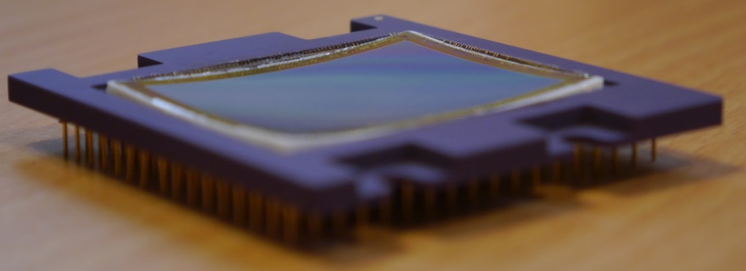
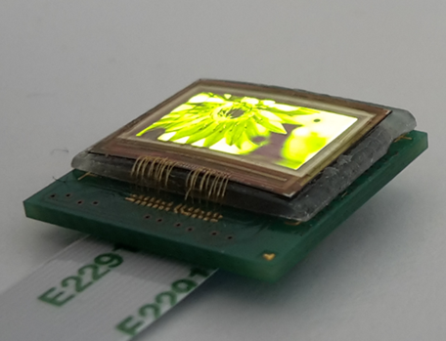
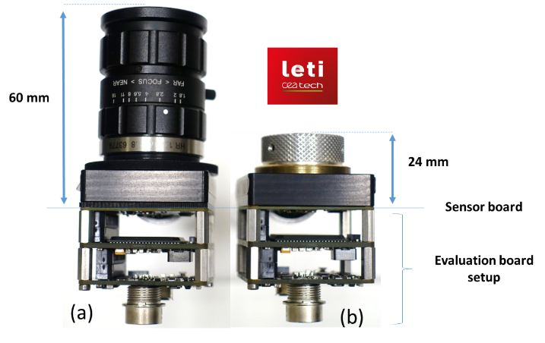
PIXCURVE
Demo on BOOTH 431
Our technology of component curvature allows a considerable simplification of the optical system while preserving the component performances.
Image sensor or display curvature to simplify optical systems

Slide 7
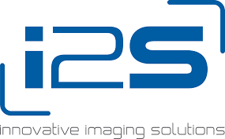
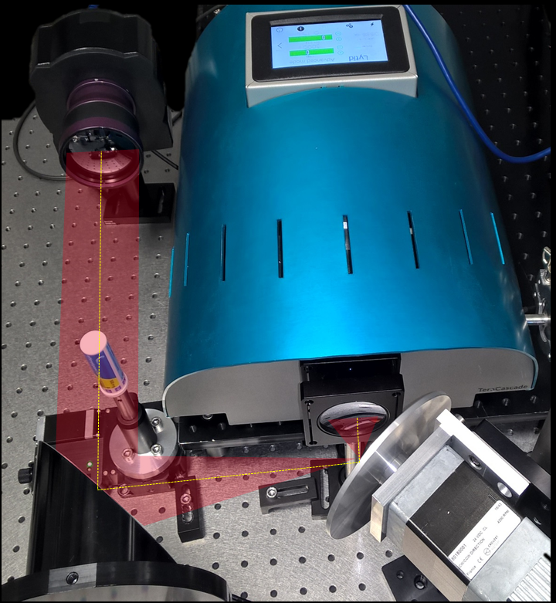
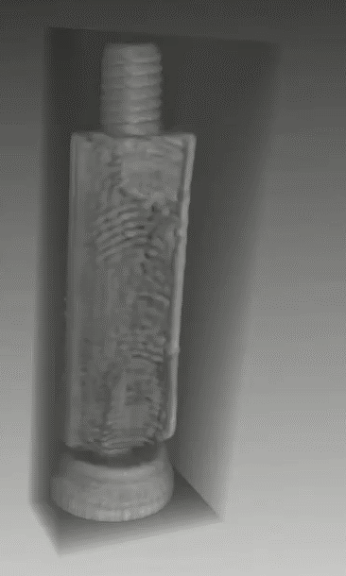
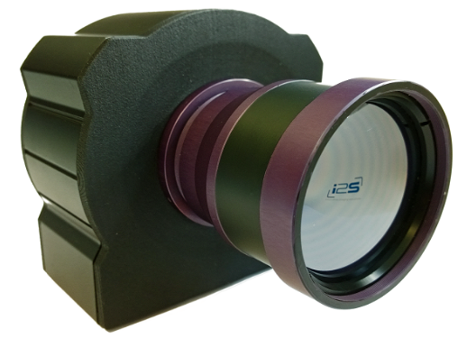
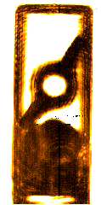
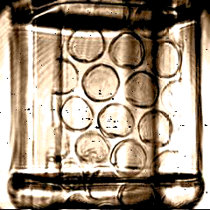
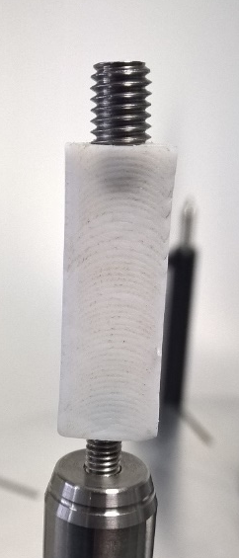
Real-time THz image sensor
Booth 437
Wing nut in an aspirin tube
Piece of bubble pack in a plastic flask
3D reconstruction of a screw in a Teflon piece
CMOS-compatible large format real-time THz sensor.
Camera integration by i2S company.
Application test platform in Bordeaux near i2S (sensor Leti, camera i2S, THz source from Lytid).
Pioneering real-time THz imaging

Slide 8


OUR BUSINESS MODEL
One-to-One collaboration to create and transfer new technologies to our industrial partners
FOCUS ON OPTICS AND PHOTONICS DEPT
Mass production
Pilot line
TRL 1 2 3 4 5 6 7 8 9
Technological
Research
Industrial partner
Basic
research
Proof of concept
DIFFERENTIATION
Developping hardware technologies to obtain smaller, cheaper and smarter photonic products for our industrial partners.
Notes:
LETI’s business model is to create and transfer innovation to its industrial partners.
Leti is positioned between academic research and industrial research

Slide 9
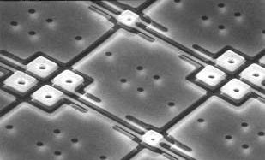
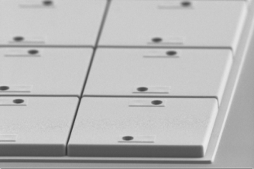
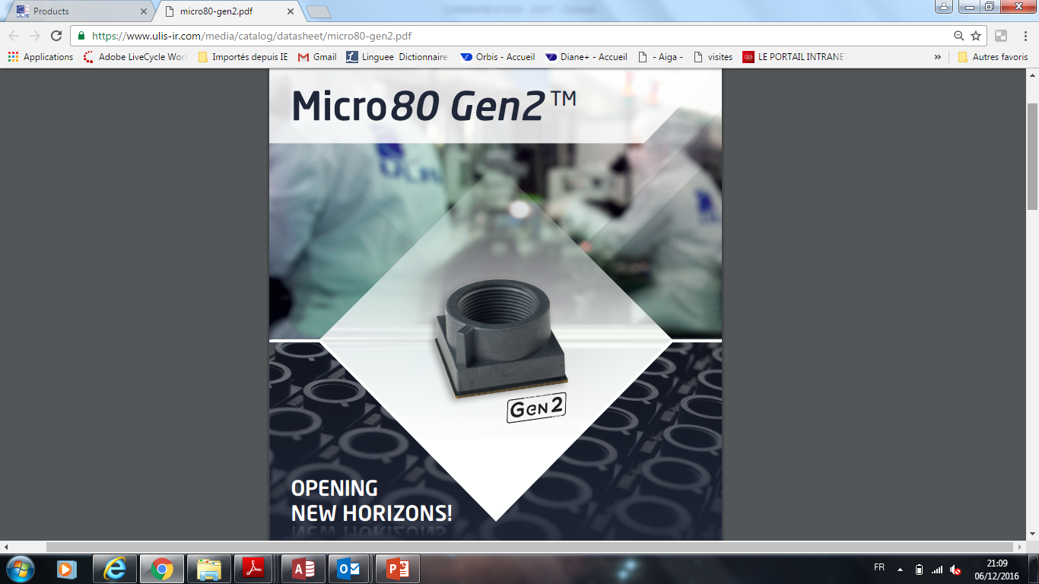
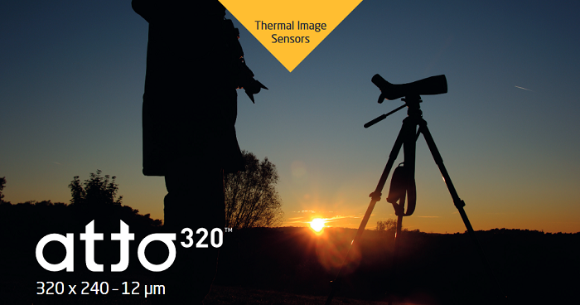
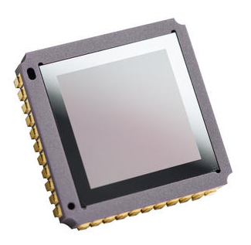

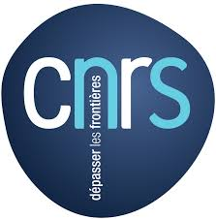

Success Story: Enabling Affordable Infrared Imaging with ULIS
2016
New 2017
In the frame of a long term collaboration with Ulis, Leti develops new technologies for bolometric image sensors and transfers them to ULIS for production. In 2017, Ulis launched ATTO320 an affordable 12µ pitch IR sensor for consumer and industrial applications.
Affordable Infrared Image Sensor for Leisure, Automotive and Home applications

Slide 10
More than reality, powered by photonics
Display
New technologies and systems to display digital information in the physical world
Communicate
Silicon photonics enabling rich digital information anywhere, anytime
Sense
Optical sensors bring digital insight in our environment
Image
Seeing the unseen: lensless imaging
DIGITAL REALITY

Slide 11
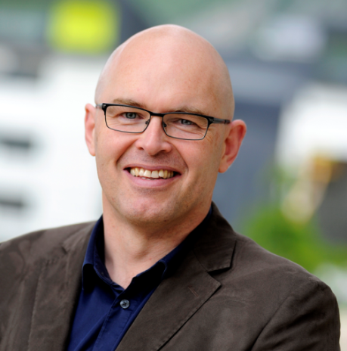


Meet Leti experts at booth #431, French Pavilion
Leti Innovation Days
July 4-5, 2018

